Slide 1

MediCare
Team Name: Amigos
Team Members :Shalini Chandra 001062801
Vardhana Bhatt 001064528
Karishma Murde 001065741

Slide 2
Problem Statement
There are a number of old age homes across the world, but very few of them have enough resources
We propose to develop a Java Swing application to collaborate various organizations involved in providing facilities to Old age homes across the world
The application would act as a mediator between the Trusts, Old age homes and Members of society
It will allow the users to provide services such as Basic Amenities, Sponsor their medications and Fund Medical Treatment and enables the Trusts to address these services.
We will then be able to monitor the different types of services and their resolutions, and view statistics regarding the same.

Slide 3
Proposed Solution
Maintaining a database of all the registered Trusts present across the world and their current projects grouped by their location and the services that they offer.
Helps the organizations involved in supporting old aged people by building a bridge between them so that they could communicate and reach out to the Old Age Home. The system will allow users to request for services such as medical treatment ,medicines and provide amenities to Old age home.
The system will be able to analyze the performance of the Trusts based on the number of cases that receive and the number of cases the services are provided
Registered users will be able to look for Trusts in the vicinity and apply for available job vacancies and volunteering services. The application would also allow the users to check up on the job application status
The Trust head will have access to all the branches and can monitor the progress of a specific branch and take actions accordingly to improve overall performance.

Slide 4
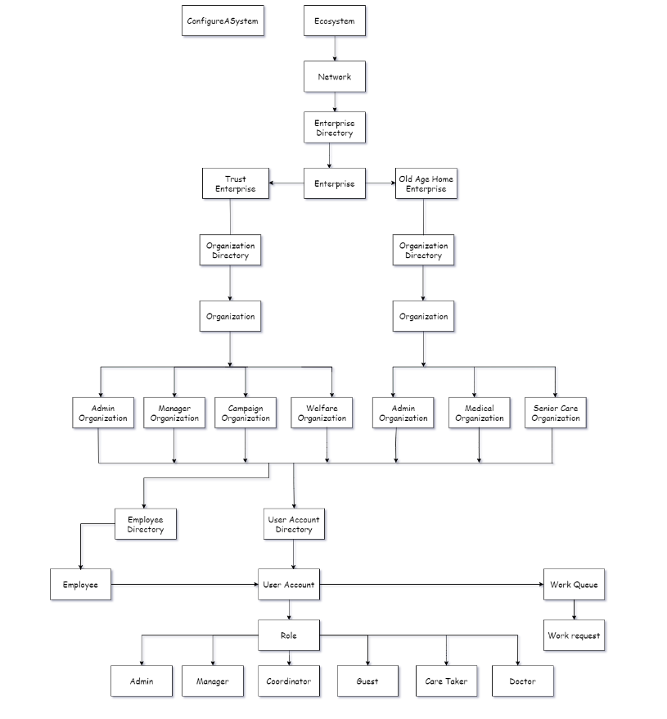
Eco-System Architecture

Slide 5
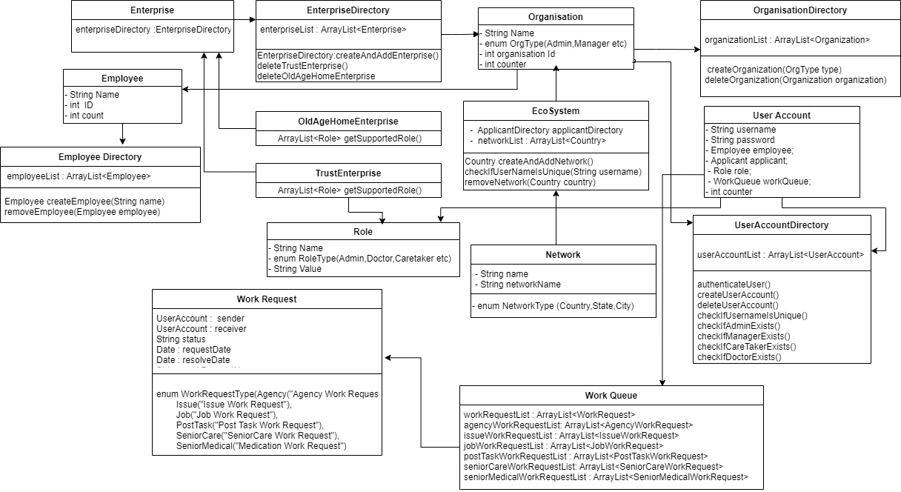
UML Diagram

Slide 6
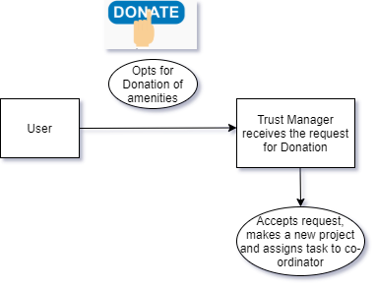
Work Flow – Donation of Amenities (Organization to Organization)

Slide 7
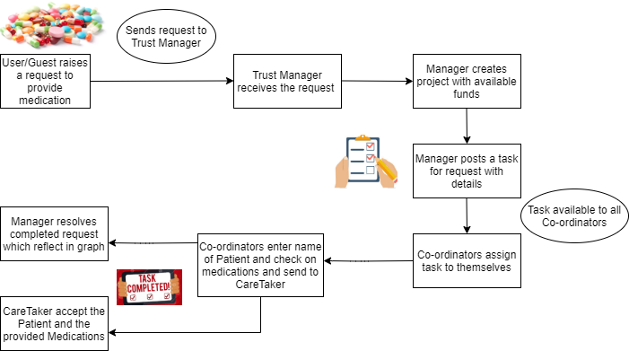
Work Flow- Provide Medications (Enterprise to Enterprise)

Slide 8
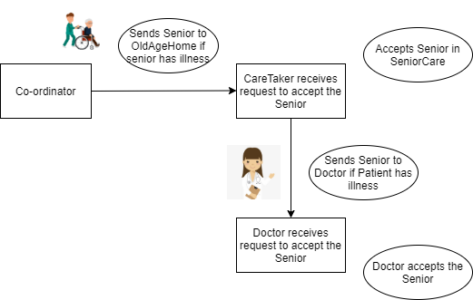
Work Flow- Provide Treatment (Enterprise to Enterprise)

Slide 9
Roles
1. System Admin
2. Manager
3. Coordinator
4. Guest User
5. Applicant
6. CareTaker
7. Doctor

Slide 10
Capabilities
Applicant: Applicant can apply for a job in Trust and Old age Home and can view his application status.
Guest: Guest can raise an ongoing service request, can sign up as a funding agency and can view Trust and old age home details.
System Admin: System admin can manage Country, state, city networks and can also manage Trust and Old age Home in these particular networks.
Admin : The admins of both Trust and Old age home can manage their organization respectively , publish jobs, Manage job applications and manage the employee user account.
Manager: Manager manages the tasks posted by guests, assigns tasks to coordinator ,creates projects as well as manages the funding agencies.
Coordinator: Coordinator can view any ongoing service request and take up the request to work voluntarily. He also updates the status of the service request.
CareTaker : Accepts the Old Age people from the Coordinator, Keeps the records and assigns the senior citizen to the Doctor based on illness.
Doctor : Accepts the Senior Citizens from Care Taker.

Slide 11
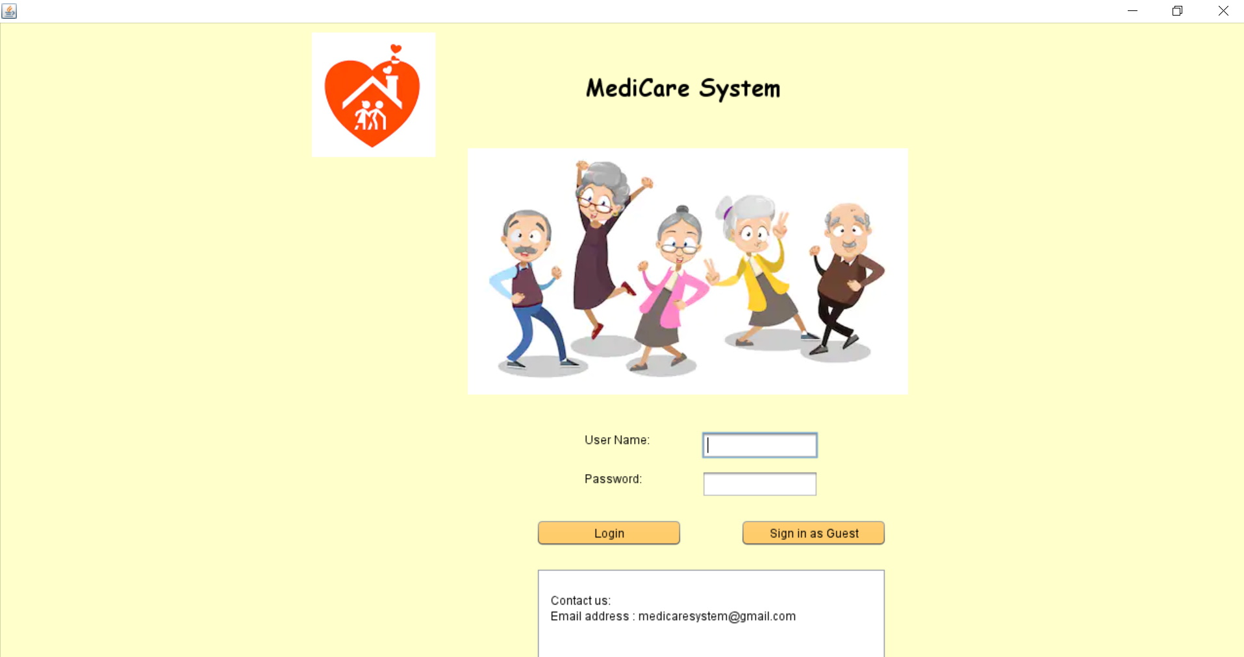
Login Screen

Slide 12
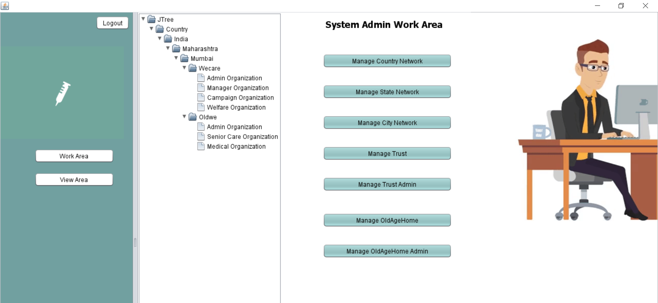
System Admin Work Area

Slide 13
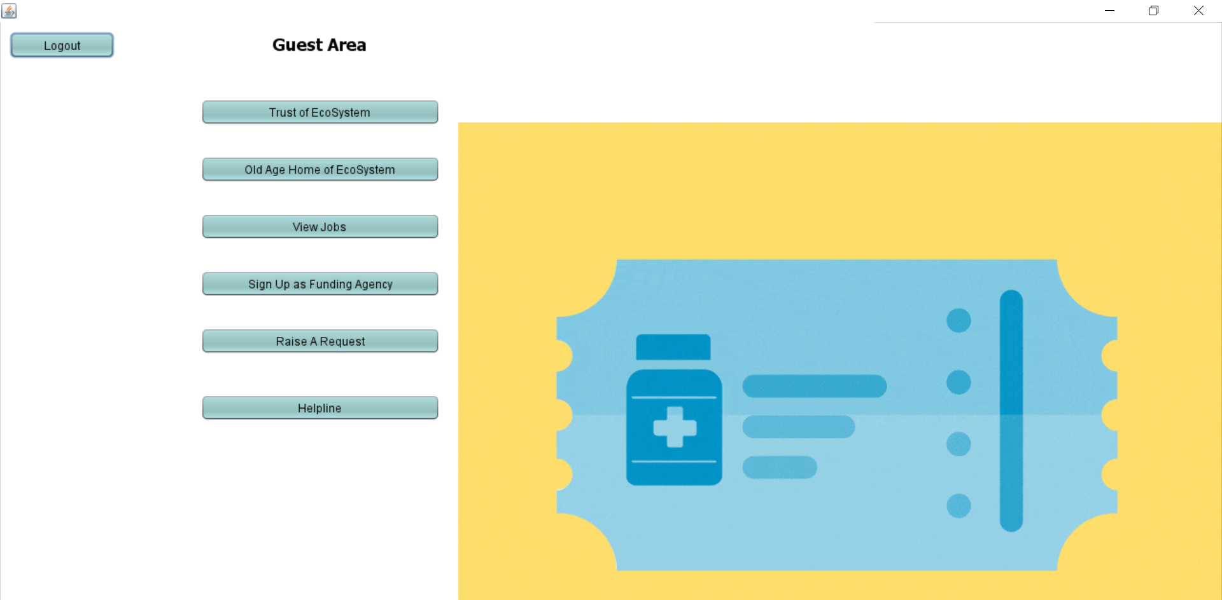
Guest Work Area

Slide 14
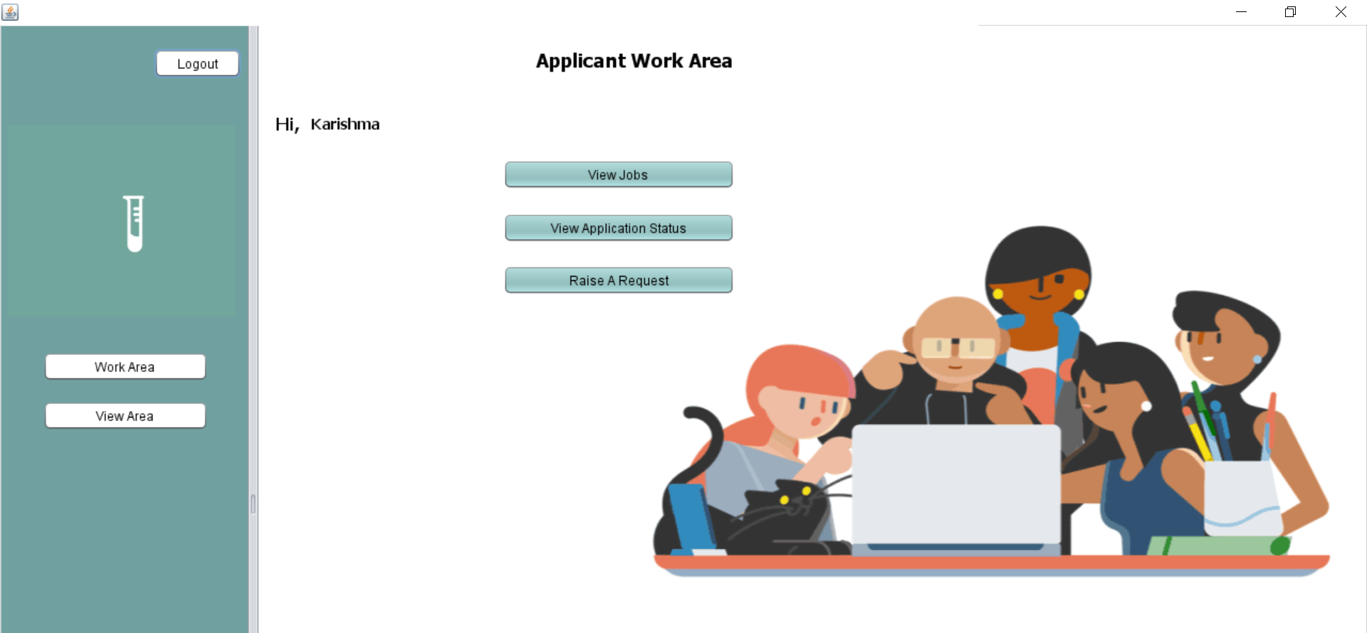
Raise Request

Slide 15
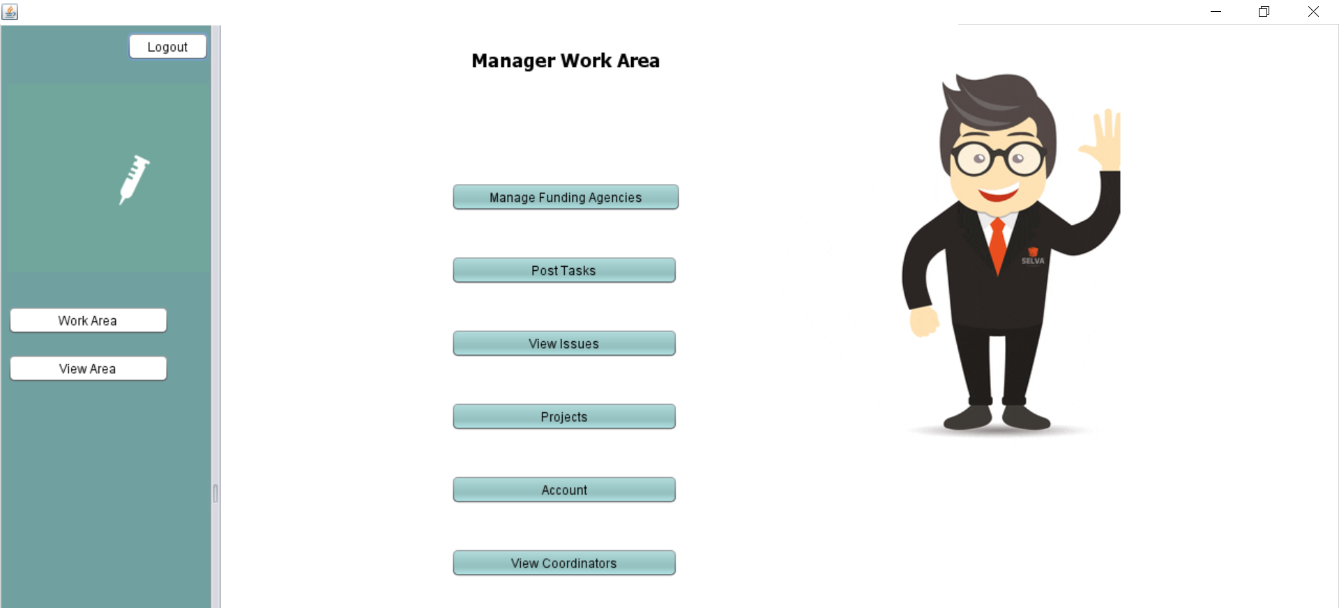
Manager Work Area

Slide 16
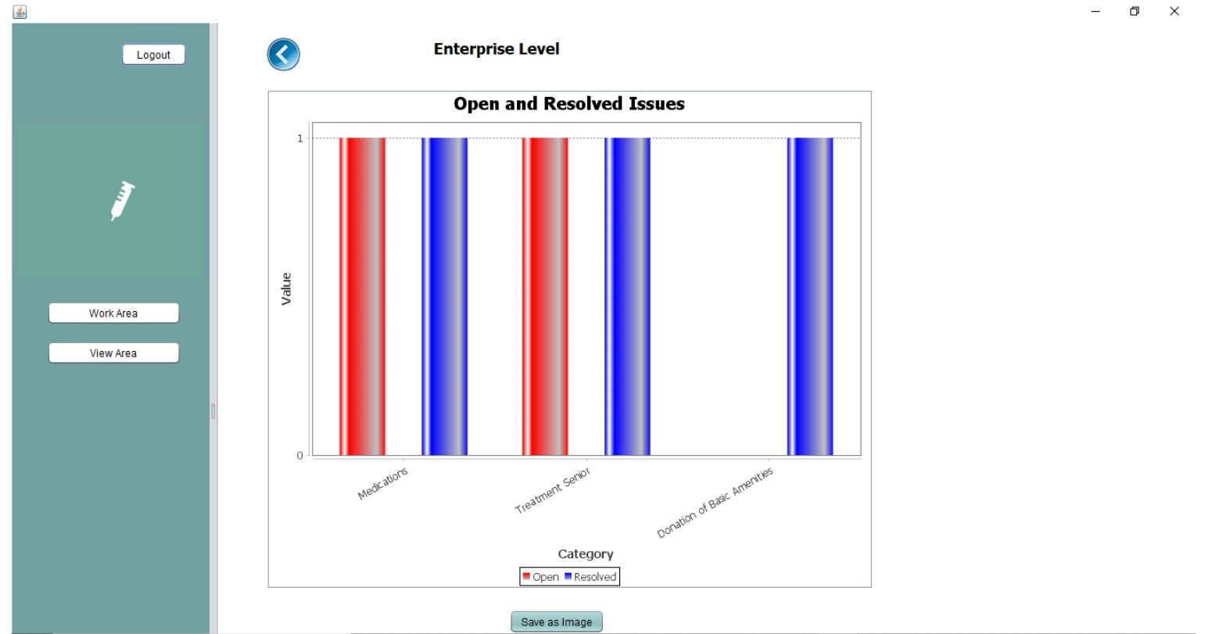
View Request Status – Bar Graph

Slide 17
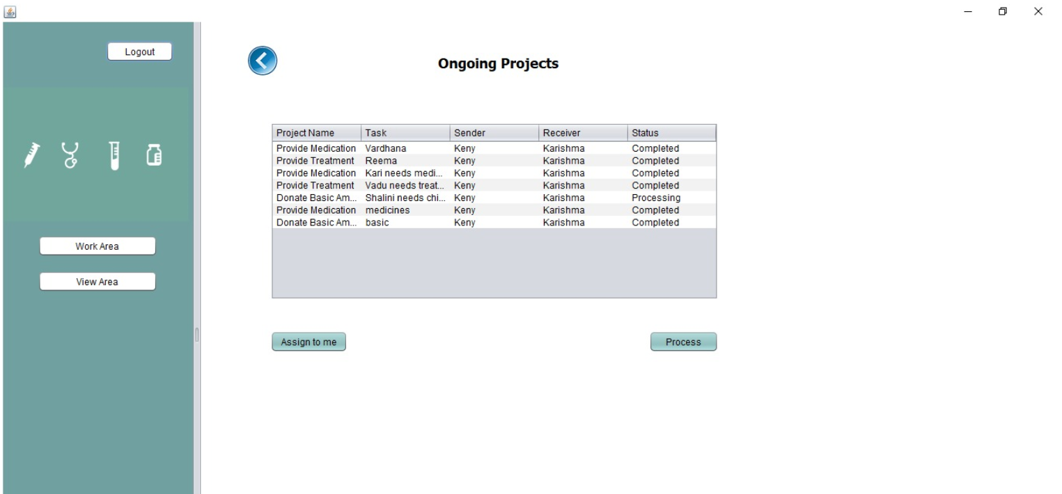
Coordinator Work Area

Slide 18
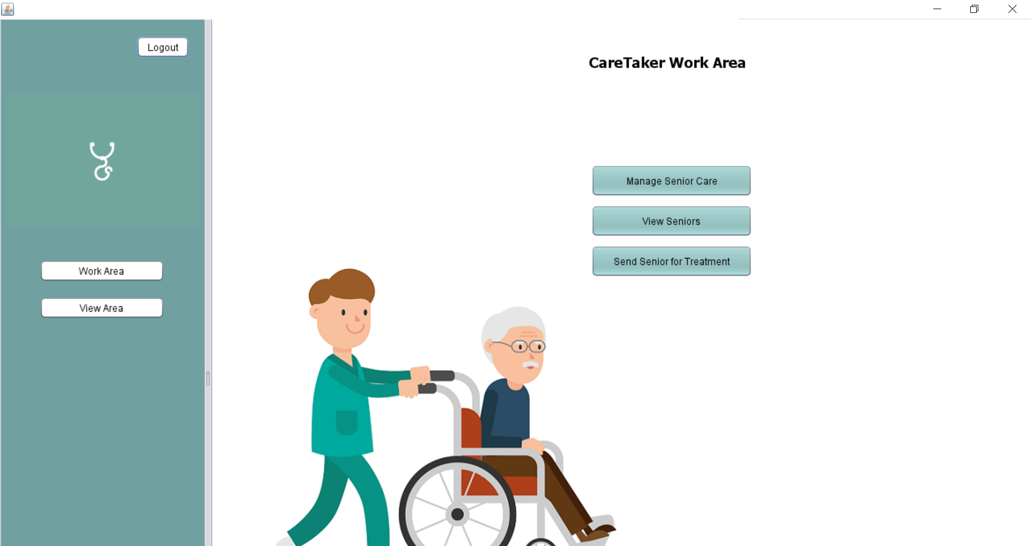
CareTaker Work Area

Slide 19
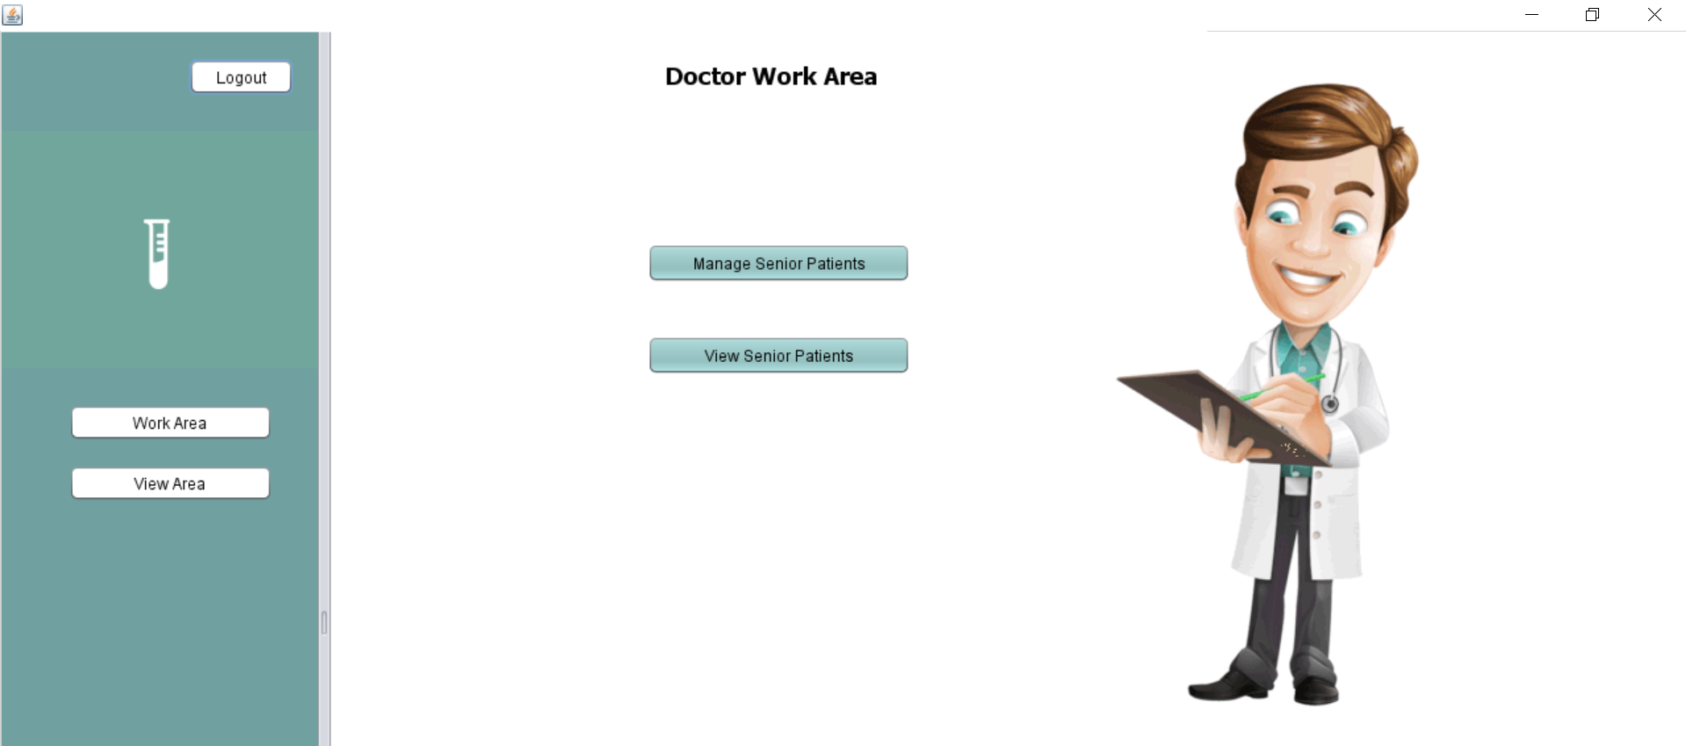
Doctor Work Area

Slide 20
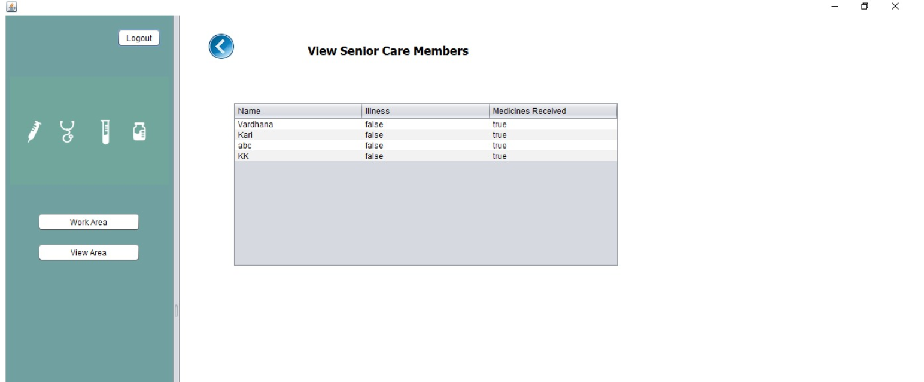
View Senior Care Members

Slide 21
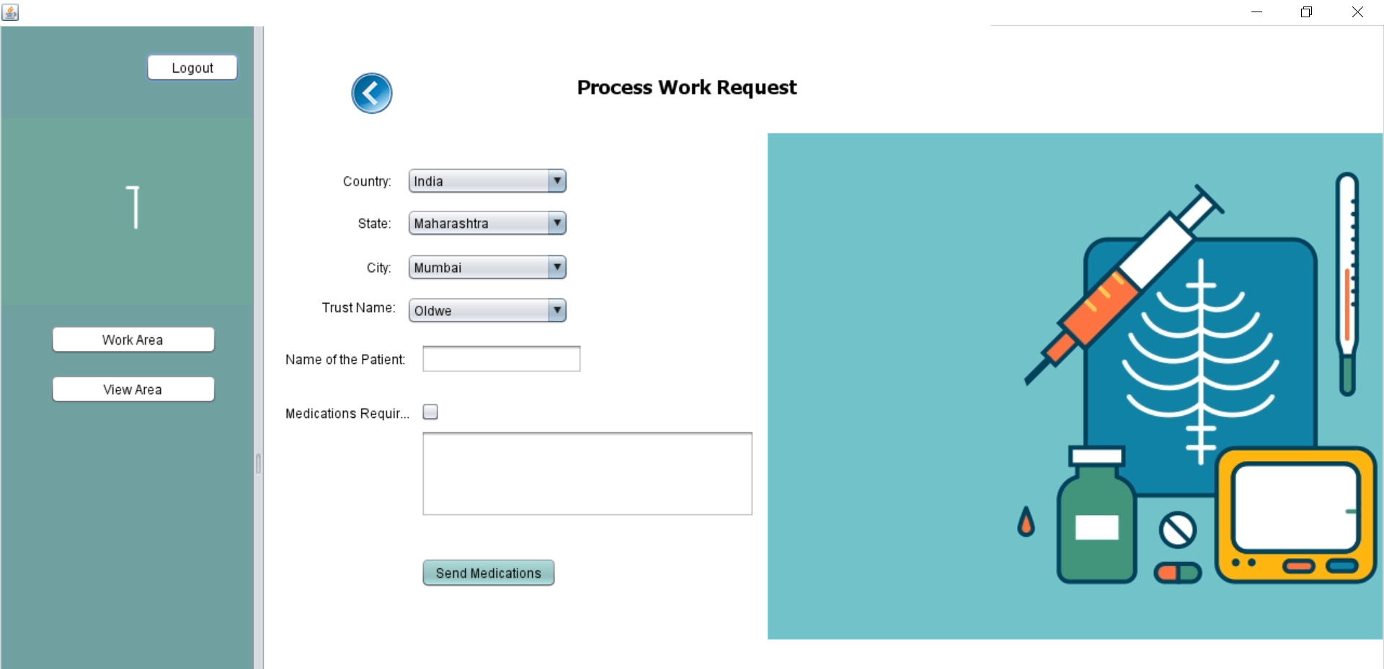
Send Medications for Senior

Slide 22
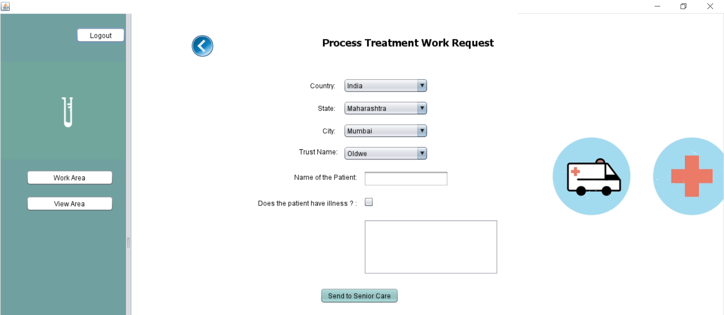
Send Senior for Treatment

Slide 23
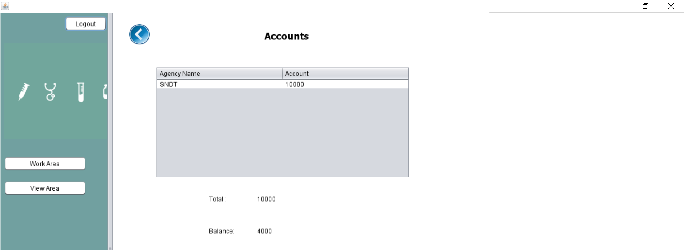
Trust Finance Account

Slide 24

Future Scope
Our system aims to help those in need, this help can be extended to following as well:
Orphanages : We can add enterprise for orphanage networks which can manage work requests like child education and child adoption
Stray Animals : We can also add an enterprise for rescue animals and add work requests like donations for rescued animals and pet adoption

Slide 25
Thank You

